Slide 1

UVM RAL

Slide 2
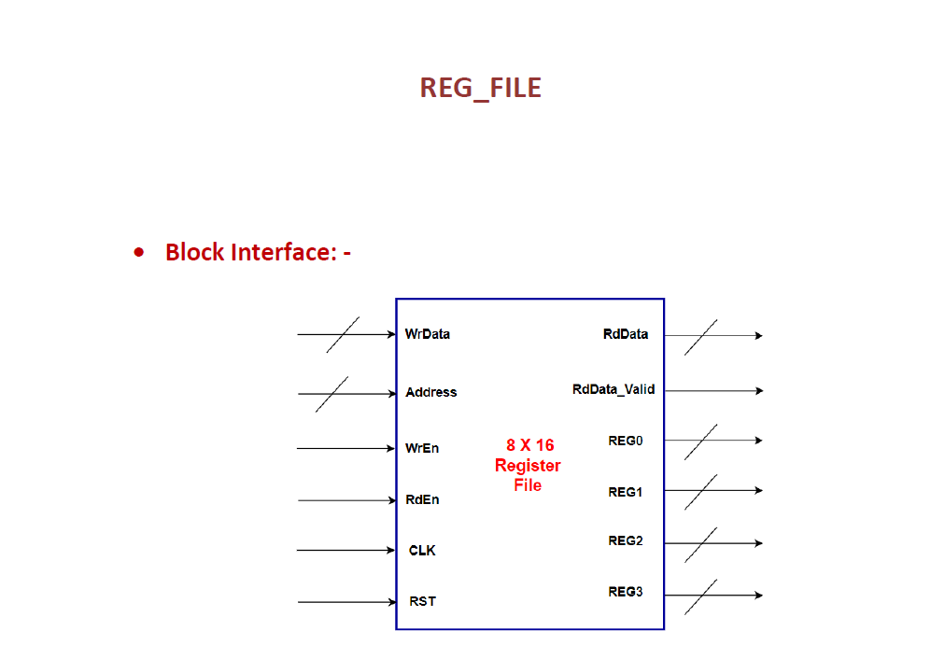
REG_FILE DESIGN

Slide 3
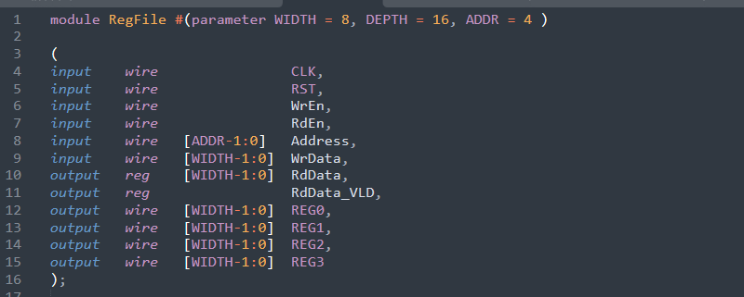
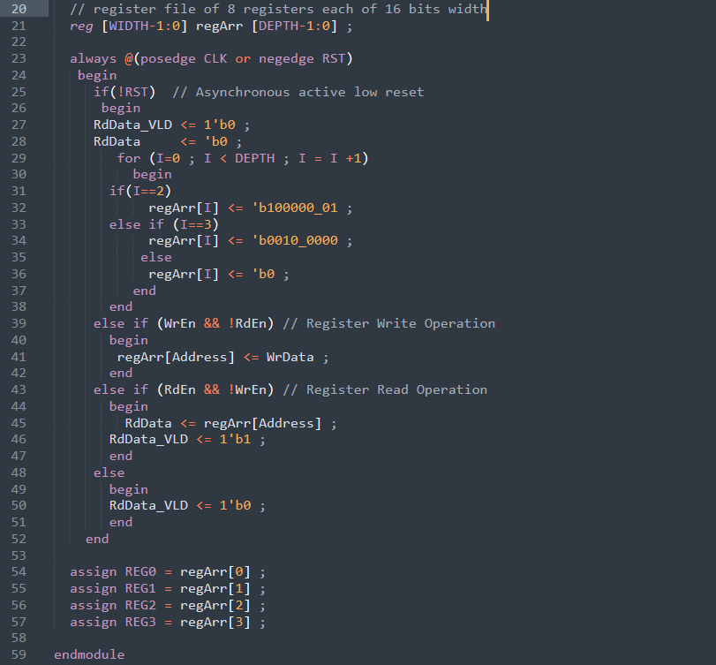
DESIGN.V

Slide 4
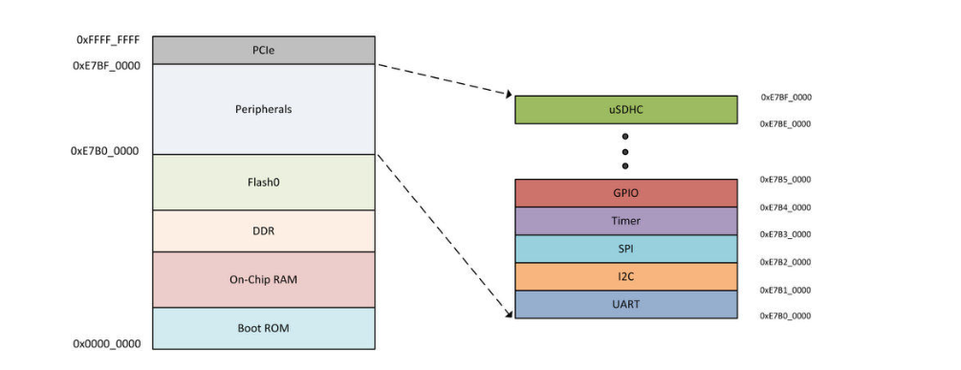
What is RAL (Register Abstraction Layer)
"The purpose of Register Abstraction Layer or RAL is to provide a structured and standardized way to model and verify registers and memory-mapped structures within a digital design.
Verification of register behavior can include testing different access scenarios, checking field values after resets, verifying register side-effects, and more

Slide 5
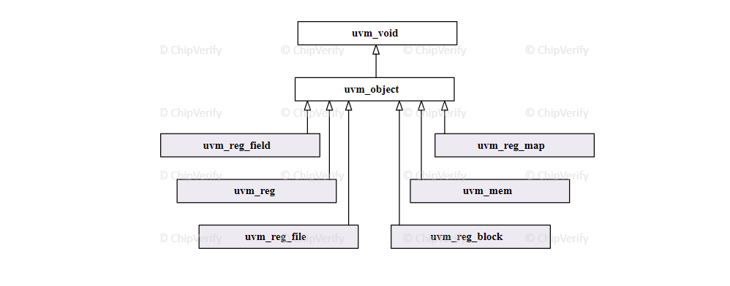
RAL CLASSES

Slide 6
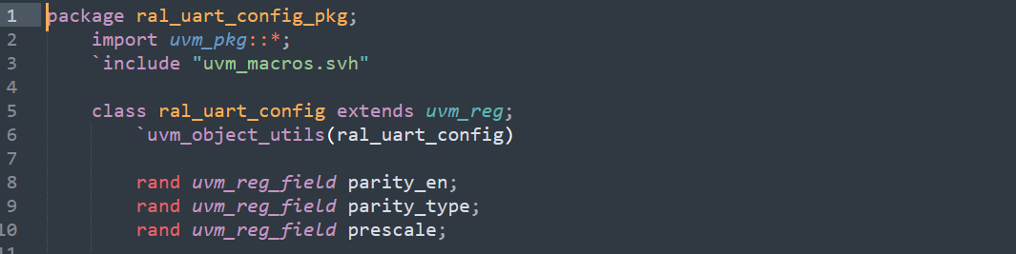
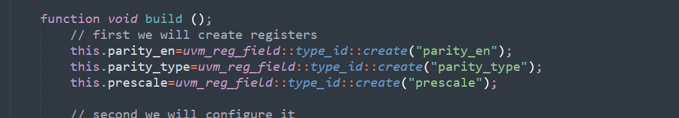
1- UVM_REG && UVM_REG_FIELD
uvm_reg → object
7
2
1
0
prescale | Parity_type | Parity_en

Slide 7
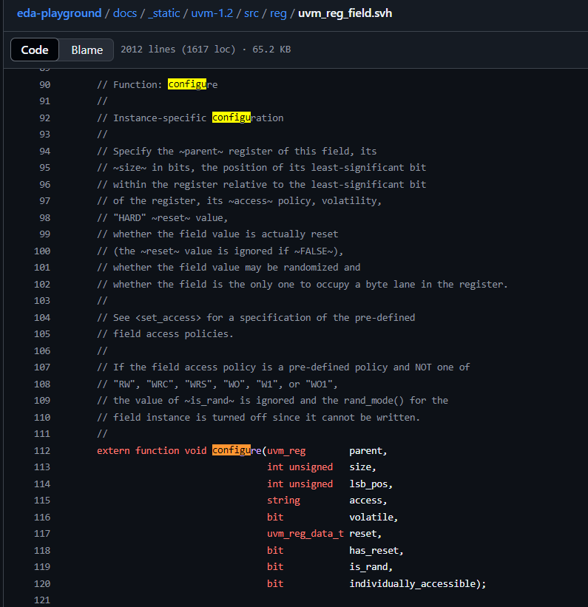
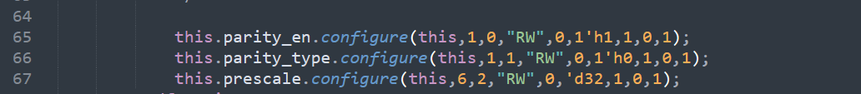
Configuration

Slide 8
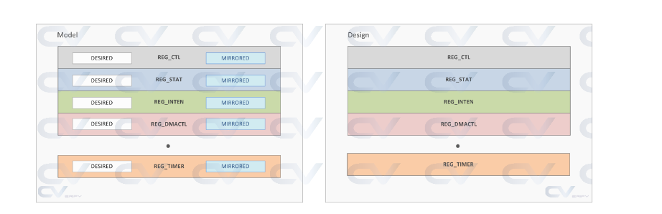
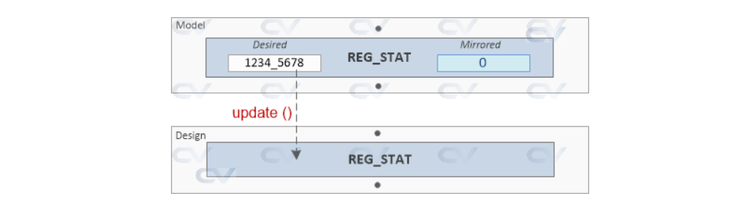
DESIRED AND MIRRORED VALUES

Slide 9
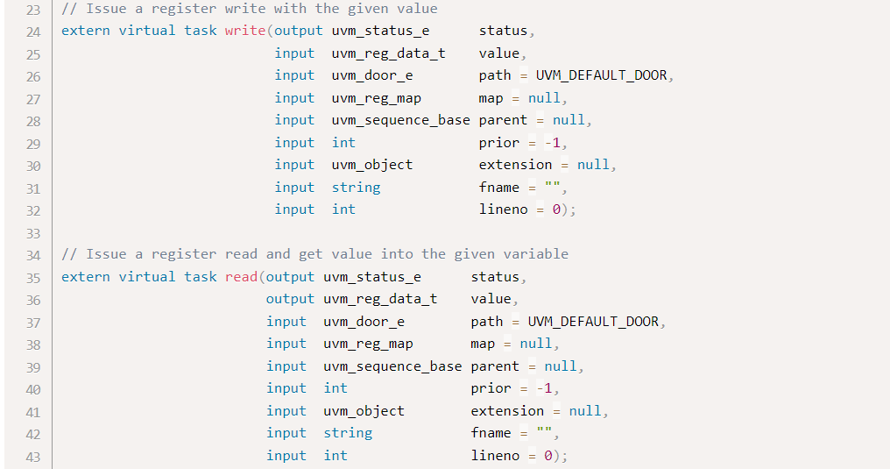
BUILT IN FUNCTIONS 1

Slide 10
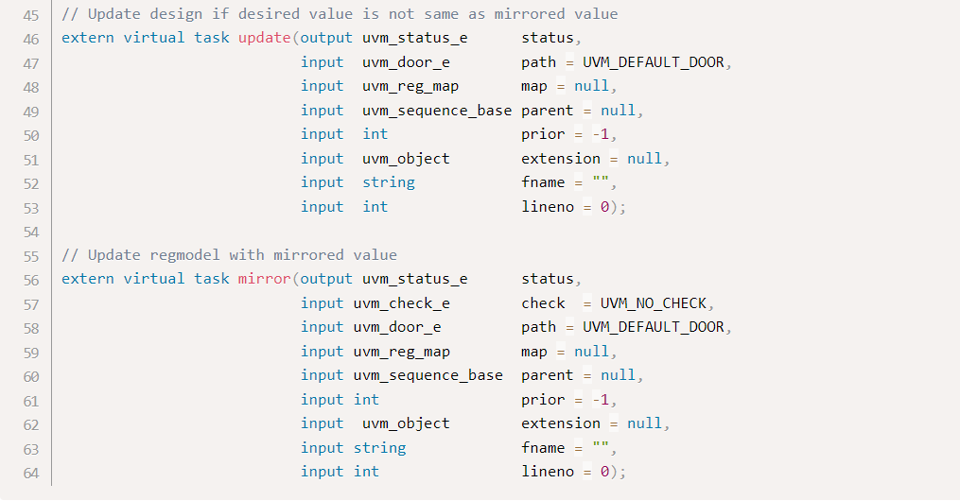
BUILT IN FUNCTIONS 2

Slide 11
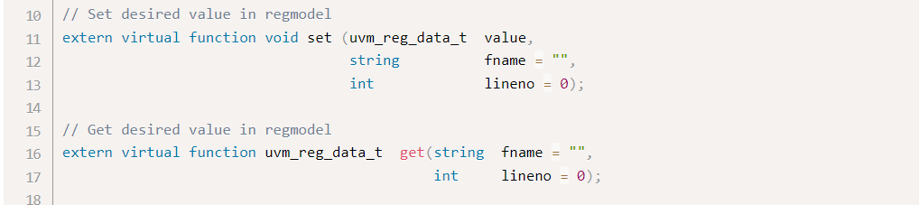
BUILT IN FUNCTIONS 3

Slide 12
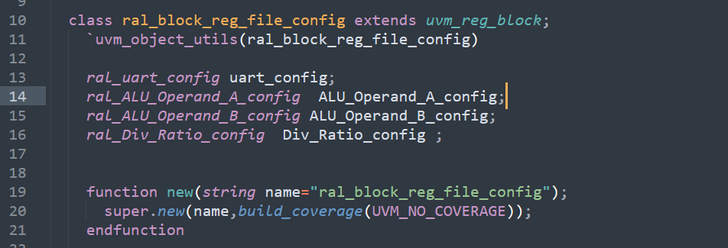
UVM_REG_BLOCK

Slide 13
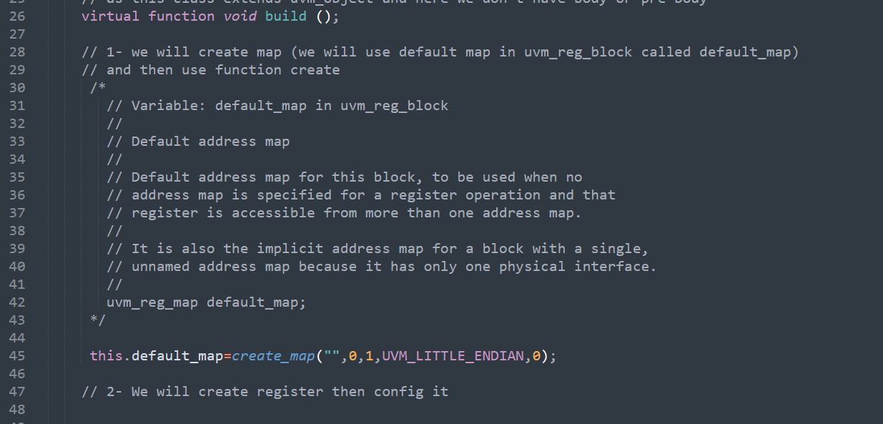
UVM_REG_BLOCK

Slide 14
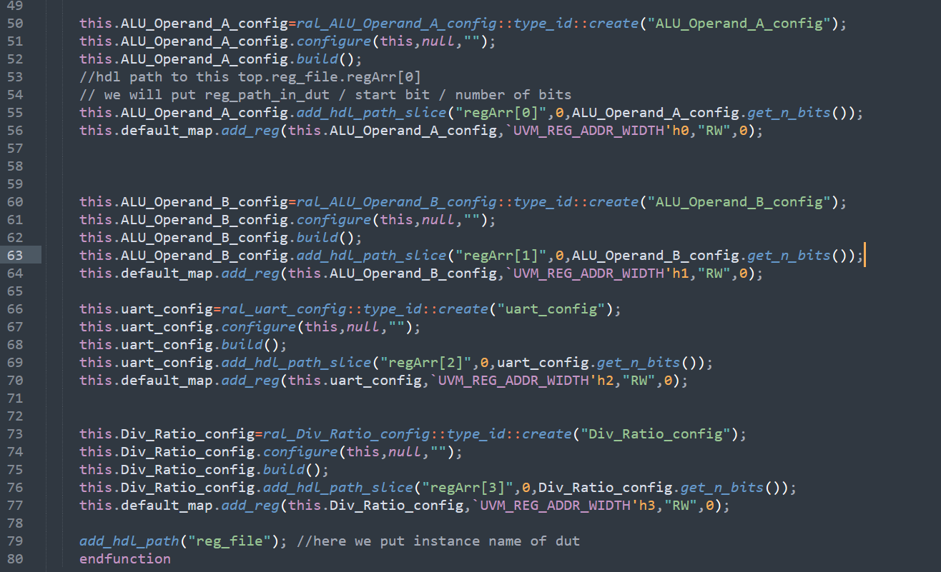
UVM_REG_BLOCK

Slide 15
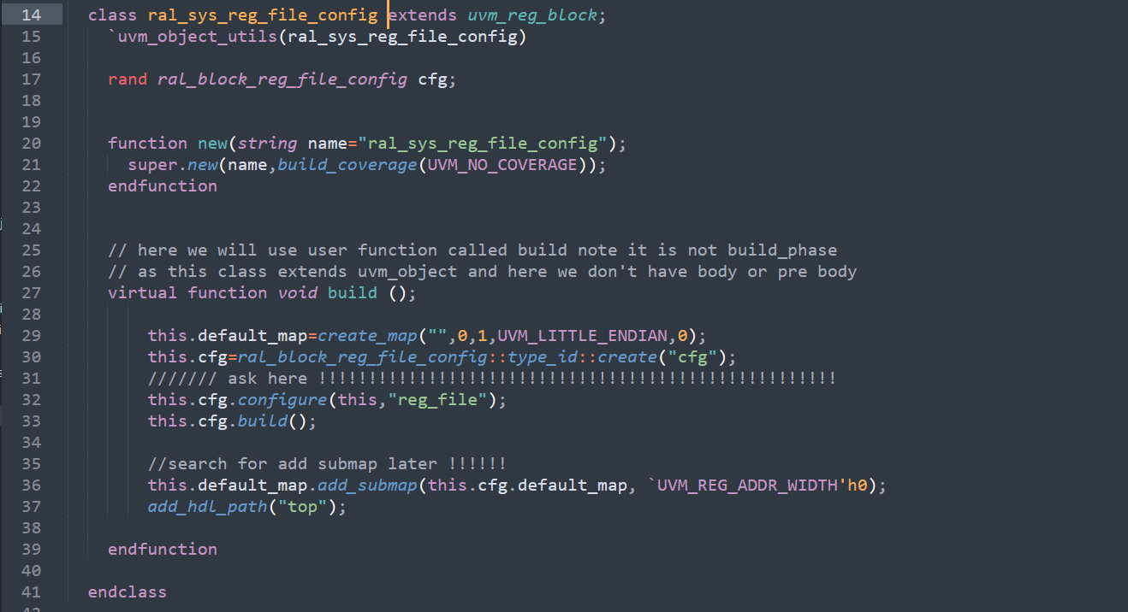
Top level UVM_REG_BLOCK

Slide 16
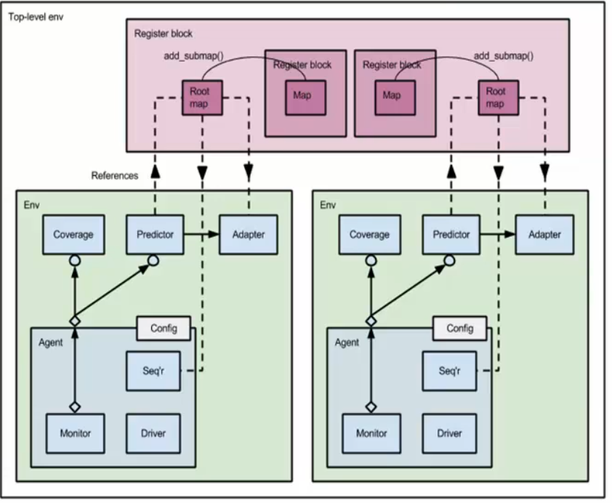
Top level UVM_REG_BLOCK

Slide 17
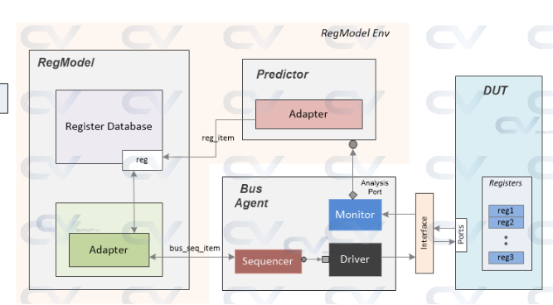
REG MODEL ENVIRONMENT

Slide 18
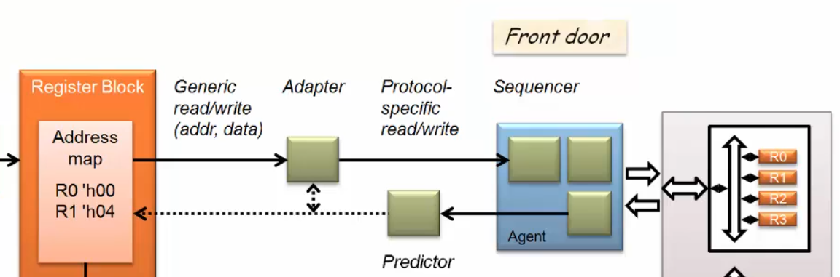
Adapter

Slide 19
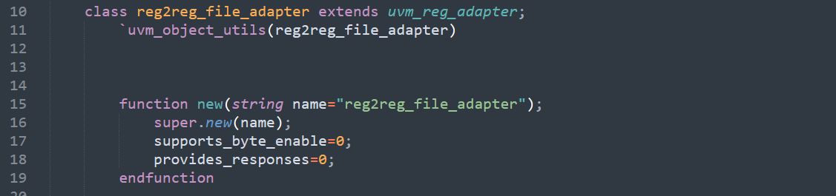

Adapter class

Slide 20
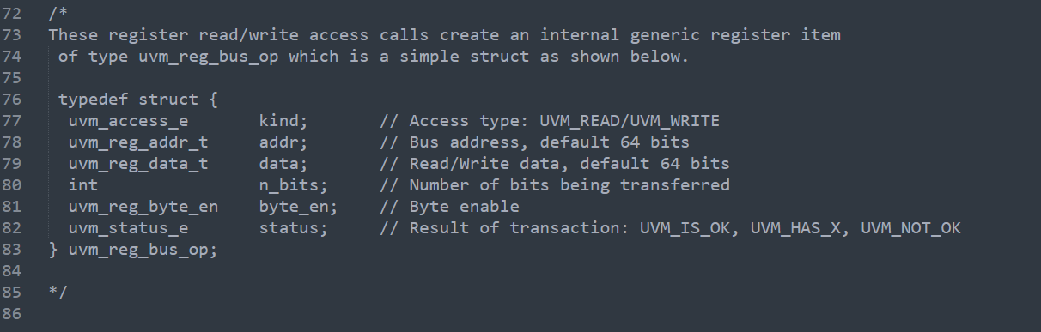
Adapter class

Slide 21
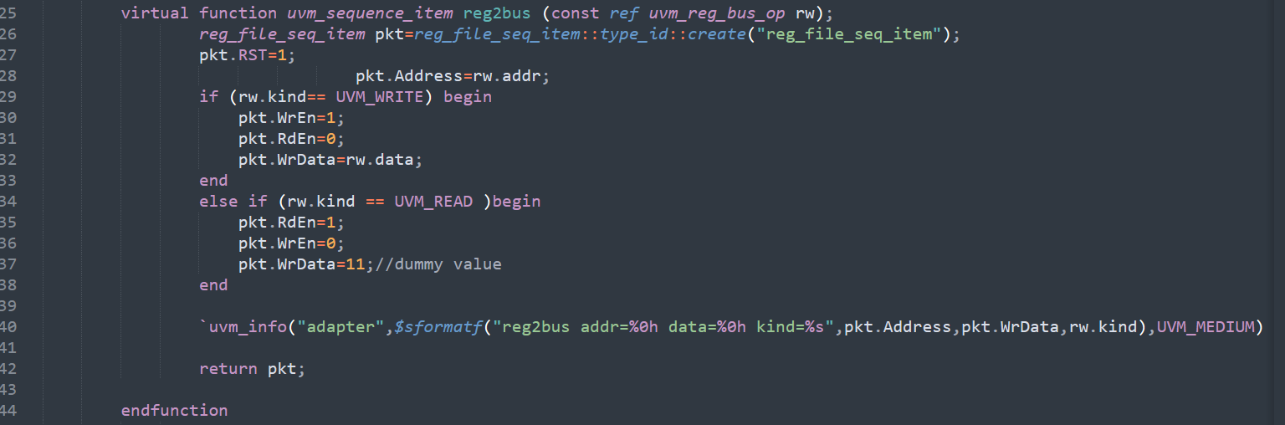
reg2bus

Slide 22
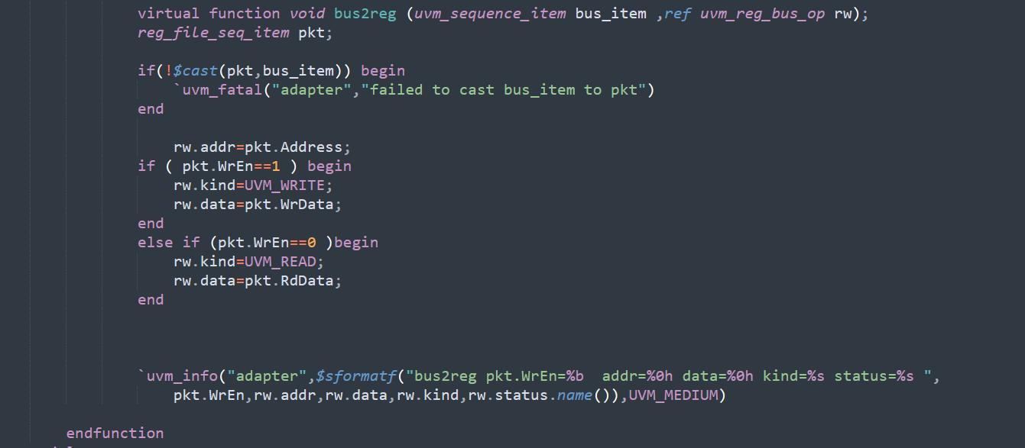
bus2reg

Slide 23
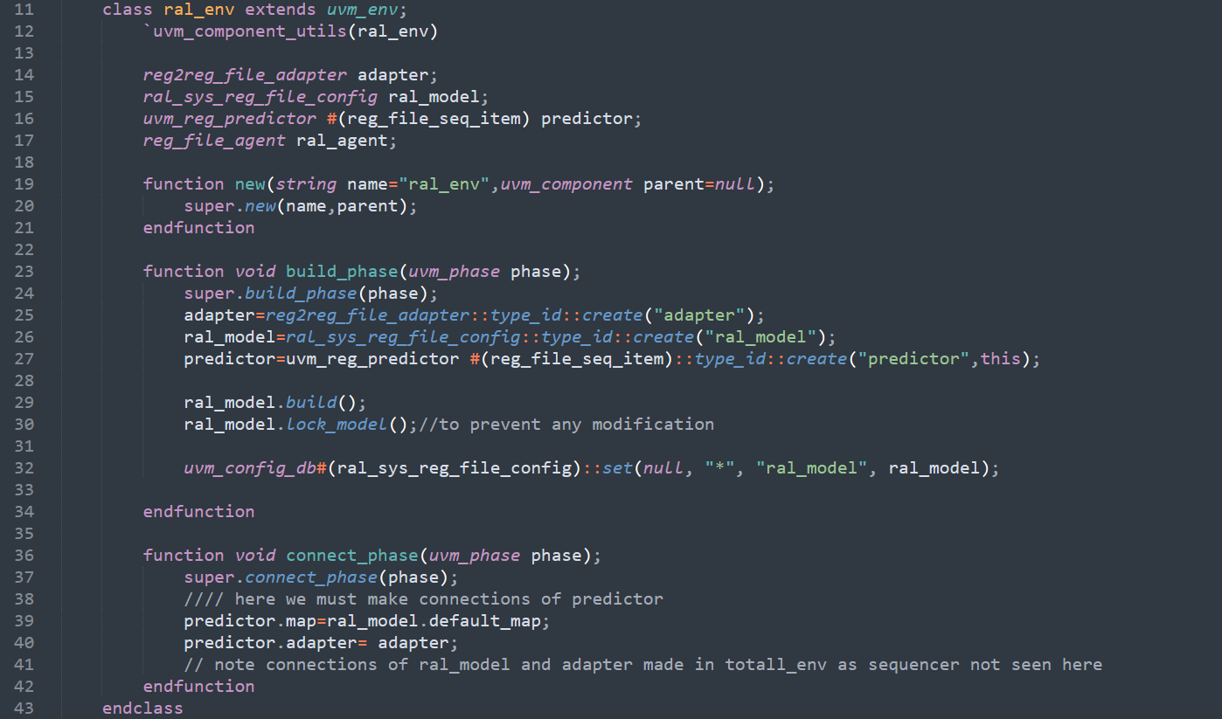
RAL ENVIRONMENT

Slide 24
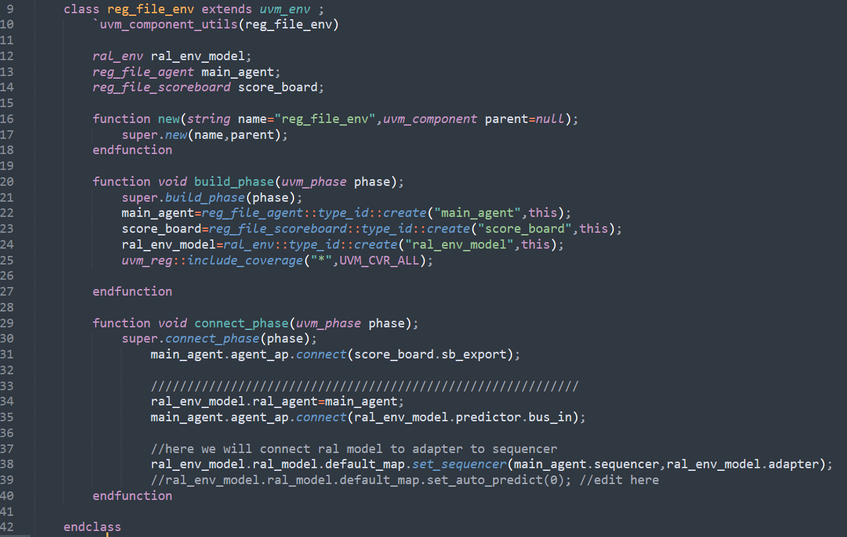
TOP ENVIRONMENT

Slide 25
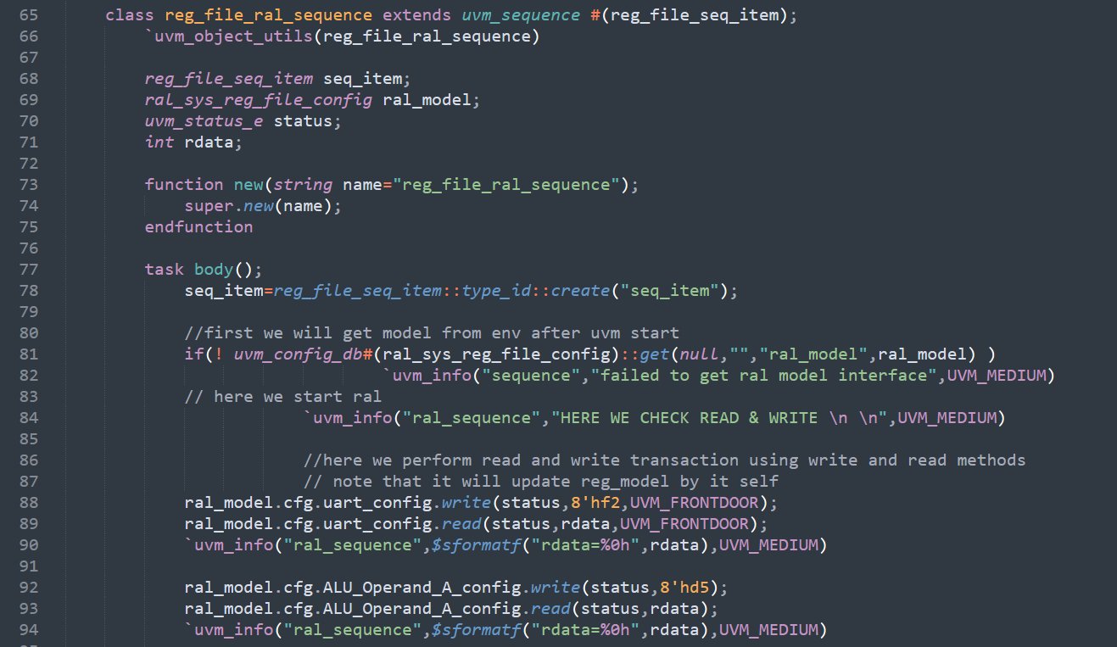
SEQUENCE

Slide 26
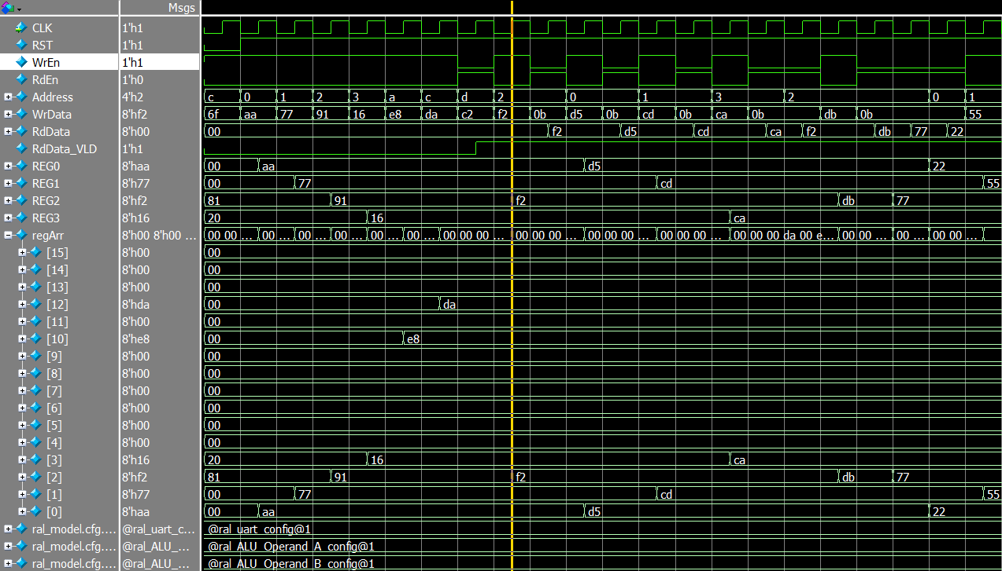
SEQUENCE

Slide 27
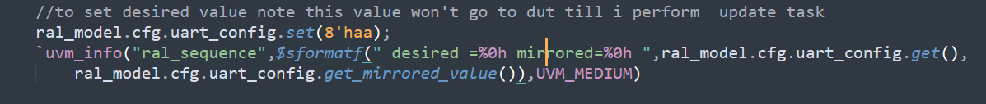
TEST 2

Slide 28
TEST 3

Slide 29
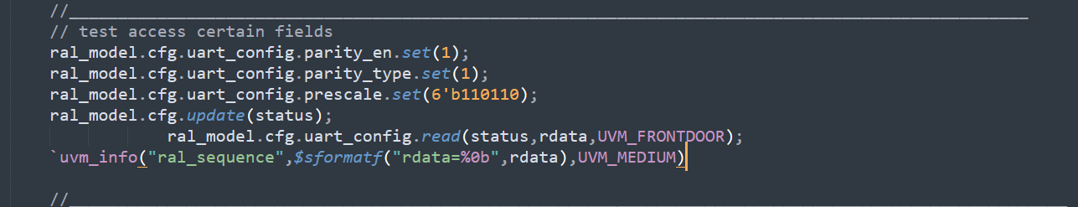
TEST 4

Slide 30
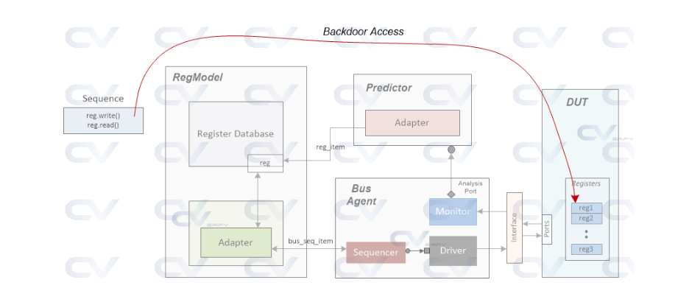
BACK DOOR
A backdoor access takes zero simulation time since the HDL values are directly accessed and do not consume a bus transaction. This is not the recommended way to verify register accesses in any design, but under certain circumstances, backdoor accesses help to enhance verification efforts using the frontdoor mechanism

Slide 31
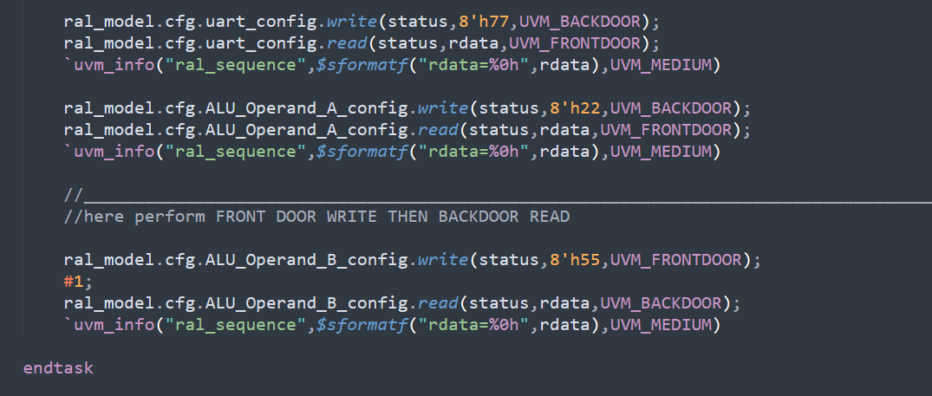
BACK DOOR TEST 1

Slide 32
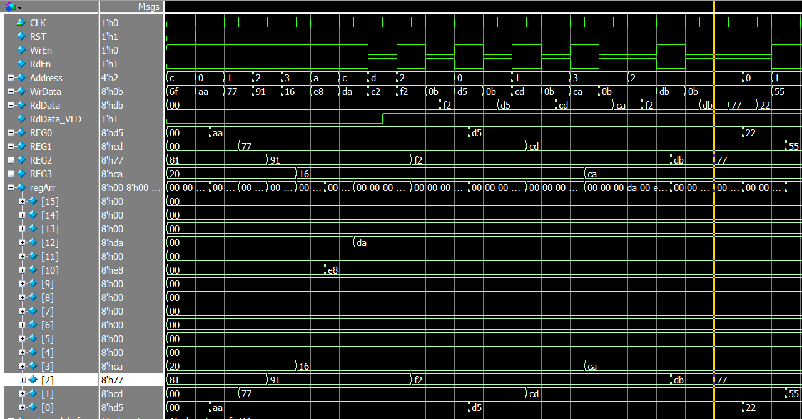
BACK DOOR TEST 1
-VE EDGE CLK

